Slide 1


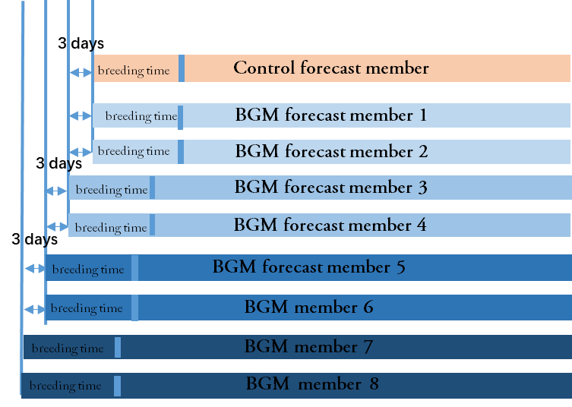
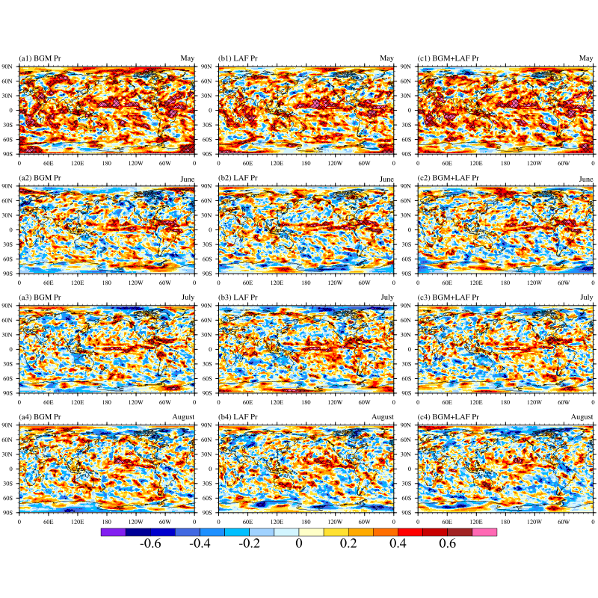
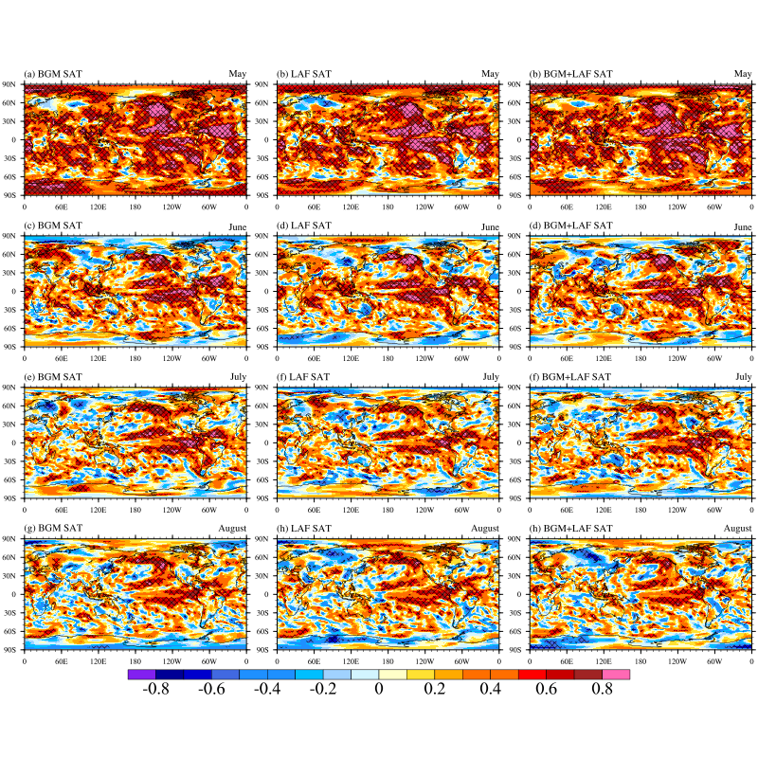
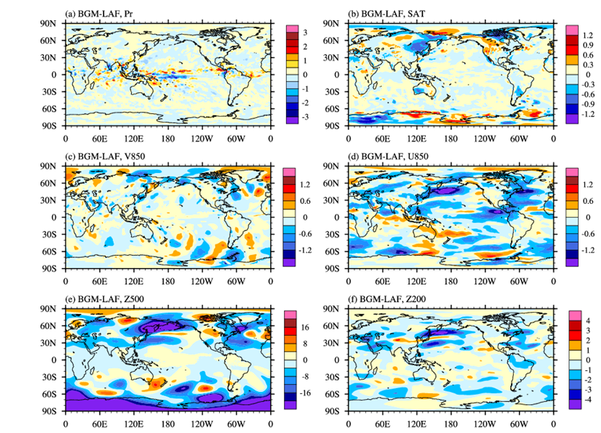
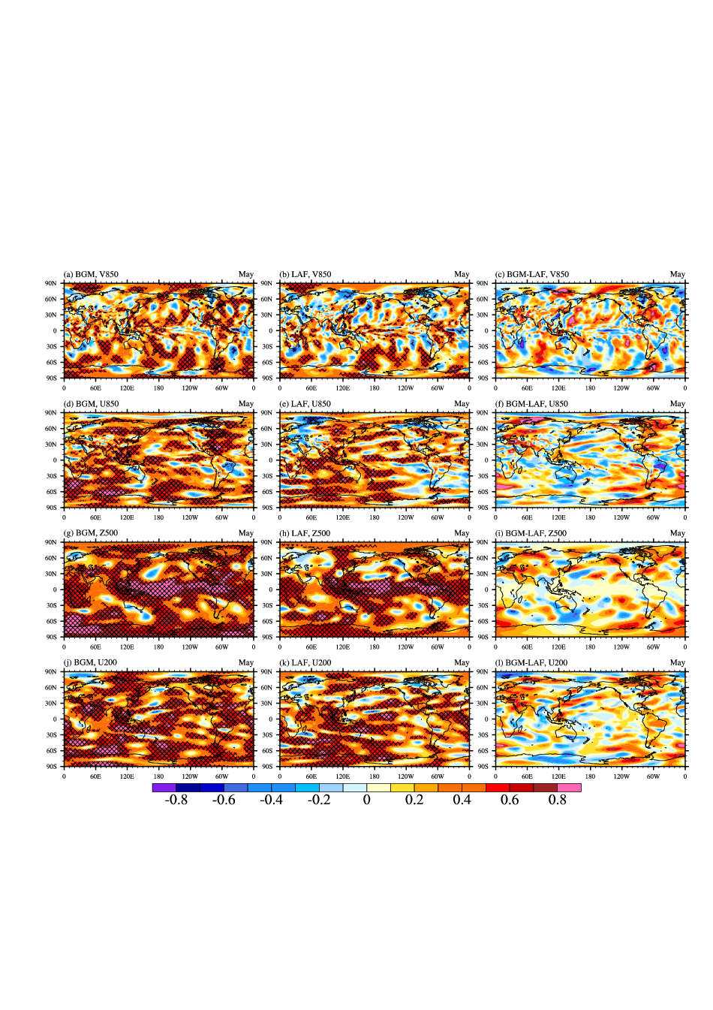
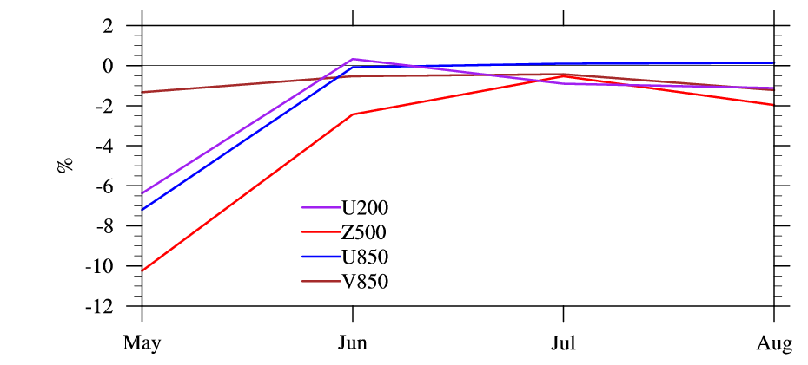
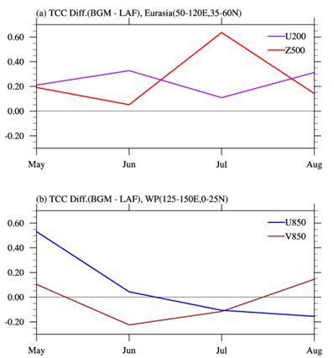
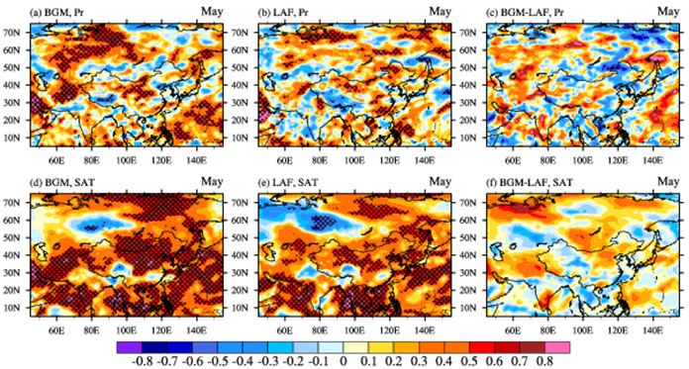
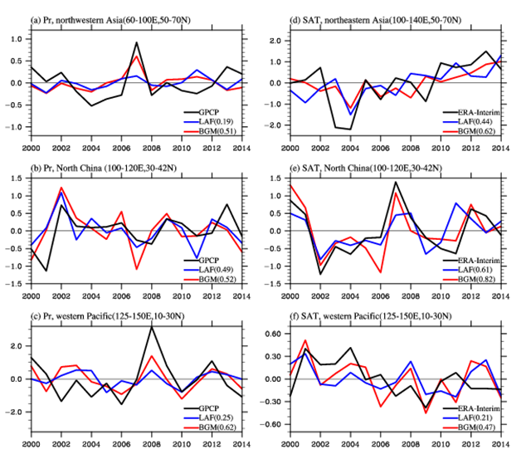
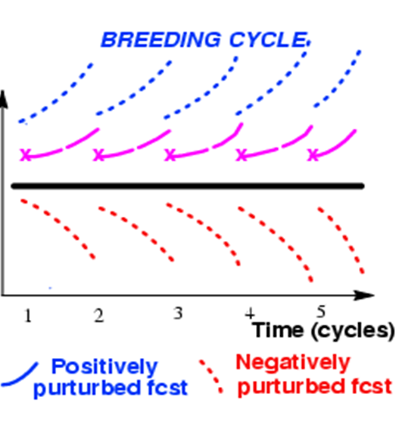
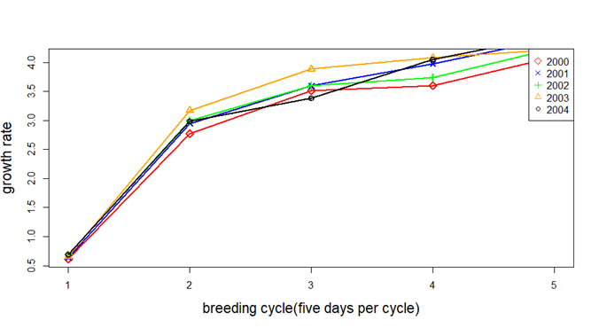
Application of Breeding of Growing Mode ensemble method in seasonal prediction of climate system model
Li Wu¹，Xiaoge Xin² ,Yanjie Cheng², Wei Xue¹
A41L-0099
1.Department of Computer Science and Technology, Tsinghua University, Beijing , China 2. National Climate Center of China Meteorological Administration , Beijing China
1. Abstract
4. Experiments
7. Discussion
The Breeding of Growing Model (BGM) method is used to generate perturbations of initial condition for sub-seasonal to seasonal forecasts of Beijing Climate Center. Ensemble forecasts with nine-members including four pairs of BGM-perturbed initials were carried out starting from May 1st and predicting for four months during each year of 2000-2014. Results were compared with the nine-member ensemble forecasts generated with the Lagged Average Forecasting (LAF) method, which is used for sub-seasonal to seasonal forecasts of Beijing Climate Center. Results show that the BGM ensembles reduce the modelled error of atmospheric circulation over most area of the globe. The RMSE of 500hPa geopotential height predicted by BGM ensembles is reduced by 10% in May and 3% in summer relative to the LAF ensembles. The temporal correlation coefficient (TCC) skills of 500hPa geopotential height and 200hPa zonal wind are superior to the LAF ensembles over Eurasia from May through August. The BGM ensembles is much better to predict the precipitation and surface air temperature over Asia and the western Pacific within one month lead time, but not beyond one month. These improvements obtained by using the BGM method indicate its success in providing more skillful sub-season forecasts.
A 15-year (2000-2014) reforecast experiment with BCC-CSM2-MR was carried out in a similar way as the LAF ensemble forecast except with the 9 member generated with the BGM method, which starts at May 1 and predicted for four months with nine members generated with BGM method. The LAF method used in the current seasonal forecasts of Beijing Climate Center is choosing eight initial conditions every three days. There are also nine-member ensembles combined with the prediction started from the control initial conditions. A 15-year (2000-2014) forecasts with 9 members of LAF ensembles were used to compare with the BGM ensemble forecasts. So the difference between the two sets of forecasts is the initial perturbations generated with different method.
The results of the season forecasts were verified against ERA-Interim for atmospheric fields, which is the latest global atmospheric reanalysis produced by the European Centre for Medium-Range Weather Forecasts (ECMWF) . The observed precipitation data used to evaluate the ensemble forecasts is from the Global Precipitation Climatology Project (GPCP) version 2.2 . Two different measures of forecast quality were employed to assess the ensemble forecasts, including the temporal correlation coefficient (TCC) and root mean square error (RMSE). .
5. Global Results
Fig.9 Schematic diagram of forecasting combined with BGM and LAF methods
Fig.10 TCC skills of precipitation
2. Background and Objective
However, the BGM ensembles cannot get substantially improvement compared with the LAF ensembles in the predicting skills longer than one month and needs to be further improved introduction in the future works.
Figure 2 shows the difference of RMSEs between BGM and LAF ensemble forecasts for precipitation(Pr), surface air temperature (SAT), 850hPa meridional wind(V850), 850hPa zonal wind(U850), 500hPa geopotential height(Z500), 200hPa geopotential height (Z200) in May. The BGM ensemble forecasts has little influence on the RMSE of precipitation except in the tropical Pacific compared to the LAF ensemble forecasts. The RMSE of surface air temperature over northeastern Asia is reduced in the BGM ensemble forecasts. Among the four atmospheric variables (V850, U850, Z500, Z200), the RMSE shows obvious decrease for U850 and U200 in most area of the Northern Hemisphere, and for Z500 in the middle and high latitudes of the globe. This indicates the BGM method is effective in reducing the modelled errors of zonal wind in the lower and upper troposphere and geopotential height in the middle troposphere with the leading time within one month.
Seasonal forecasts based on Coupled General Circulation Models (CGCMs) are receiving more and more attention. However, the initial condition uncertainty has a great influence on the seasonal forecast skill based on CGCMs. Ensemble forecasting from perturbed initial conditions is one of the most important strategies to improve the prediction accuracy. The three commonly used methods are Lagged Average Forecasting(LAF), the Breeding of Growing Mode (BGM) and singular vectors(SVs).
Although the ensemble methods are well-suited for weather and extended weather forecasting, the research on seasonal scale ensemble forecasting needs further investigation, especially the construction of a complete seasonal climate prediction system. Thus, an economically applicable climate ensemble method for seasonal scales should be further studied.
In addition, the method we also use is as shown in the figure above. Combine the BGM and LAF methods, we used the same number of members to do the same experiment as before. Unfortunately, it has no obvious improvement for long-term forecasting.
Fig.11 TCC skills of precipitation and surface air temperature
Fig.3 Difference of RMSE between BGM and LAF ensemble forecasts in May.
8. Conclusions
This study aims to establish a suitable BGM initial ensemble method in the seasonal forecast system based on BCC-CSM model for Beijing Climate Center, where LAF ensemble is still used. The forecast skill will be compared to that with LAF ensemble method to test the application prospects of the BGM method.
Fig.5 TCCs between the BGM ensemble forecast and the observation, between the LAF ensemble forecasts and the observation and the difference the BGM and LAF ACCs. The crossed regions are above the 90% confidence level.
We designed a BGM ensemble method for BCC model to solve the problem of sub-seasonal to seasonal forecasting and made a comprehensive comparison with the LAF ensemble methods.
First of all, we observed that the time period of breeding cycle of BGM was the most critical parameter to tune for climate forecasting. We chose to rescale the analysis error every five days and the analysis error saturated after four breeding cycle. And the perturbed variables included zonal wind, meridional wind, temperature and specific humidity.
Secondly, experimental results showed that the BGM ensemble forecasting can reduce the simulation errors of U200, V850, U850, Z500, and Z200 in the first month(May) on the RMSE over most area of the globe, and the betterment of the Z500 was even as high as 10%. What’s more, improvements of U850 and Z500 lasted throughout the Summer. From the perspective of TCC, U200, V850, U850, and Z500 were improved significantly in the first month, and U200 and Z500 were predicted better throughout the summer over Eurasia by BGM ensemble method.
Thirdly, precipitation and surface air temperature predicted by the BGM ensemble forecasting were much better than LAF method over Asia and the western Pacific within one-month lead time, and performed well throughout the summer. And the anomalies correlation coefficient of precipitation and surface air temperature between prediction and observation were significantly improved over Asia and the western Pacific.
3. Model and Method
As can be seen in Fig3, the RMSE decreases most prominently in May for each variable. The reduction of the RMSE for Z500 and V850 can extends to the whole summer. The Z500 decreases most prominently among the four variables. The globally average RMSE of Z500 is
Climate model version BCC-CSM2-MR was developed by Beijing Climate Center (BCC) of China Meteorological Administration (CMA). The horizontal resolution of the atmospheric model BCC_AGCM3.0 is about 1.1º (T106), and there are 46 layers in the vertical. The land surface model is BCC-AVIM2.0. The ocean component is based on the Modular Ocean Model version 4.0 (MOM4), which has 40 levels in the vertical and is hence abbreviated as MOM4_L40. The horizontal resolution of the ocean model is 1° longitude by 1/3° latitude with tripolar grid.
Fig.4 Change (%) of RMSE averaged over the globe predicted by BGM ensemble forecasts relative to LAF ensemble forecasts.
The warmer the color in Figure 4, the higher the TCC skill score. As we can see, the TCC skills of the four circulation field variables (V850, U850, Z500, U200) have been improved significantly over most area of the globe within one-month lead time.
reduced by about 10% in May, and 3%-1% from June to August. The RMSE of zonal wind at 200hPa predicted by the BGM ensemble reduces by about 2% in July and August. The RMSE of U200 and U850 in June predicted by BGM ensemble is close to those by LAF ensemble.
The selection of the initial perturbation, downscaling factor, the breeding cycle time period are important for the BGM method. Since this study focuses on the seasonal forecast, the breeding cycle and downscaling factor are different from those used in weather forecast. And the procedure of the BGM method in generating the initial condition are as follows:
6. Results of Eurasia and the Western Pacific
(a) Add a 1% arbitrary perturbation to the atmospheric analysis.
(b) integrate the model for 5 days from both the unperturbed (control) and the perturbed initial
condition
(c) subtract the 5-days control forecast from the perturbed forecast
(d) scale down the difference field so that it has the same size (in RMS) as the initial perturbation
(e) repeat the above process four times
The simulations of U200 and Z500 used the BGM ensemble forecasts achieve better results in Eurasia among four consecutive months (May, June, July and August). While in the Western Pacific region, the TCC of U850 and V850 have 53% and 10% improvement respectively in BGM ensemble forecasts in first month(May), but in the following months, the BGM is not advanced obviously compared to the LAF method.
9. References
Toth Z, Kalnay E. Ensemble forecasting at NCEP and the breeding method[J]. Monthly Weather Review, 1997, 125(12): 3297-3319.
Gneiting T, Raftery A E. Weather forecasting with ensemble methods[J]. Science, 2005, 310(5746): 248-249.
Zhang, T., Li, L., Lin, Y., Xue, W., Xie, F., Xu, H., and Huang, X.: An automatic and effective parameter optimization method for model tuning, Geosci. Model Dev., 8, 3579-3591
Kug J S, Ham Y G, Kimoto M, et al. New approach for optimal perturbation method in ensemble climate prediction with empirical singular vector[J]. Climate dynamics, 2010, 35(2-3): 331-340.
Fig.6 Difference of TCC
Fig.7 TCC skills of precipitation and surface air temperature for the BGM ensemble prediction and LAF ensemble prediction, and the difference between them.
between BGM and LAF ensemble predictions
Fig6 shows precipitation is distinctly elevated in northwestern Asia, northern China, and the western Pacific, while the surface air temperature (SAT) is improved in northeastern Asia, northern China, and the western Pacific. Figure 7 shows the precipitation and surface temperature anomalies averaged over northwestern Asia, North China, and western Pacific, which pass the significant test in Fig6, covering 15 years (2000–2014). It can be seen that all anomalies correlation coefficient of precipitation and surface temperature in the BGM ensemble forecasts are higher than the LAF.
Fig.8 anomalies of Precipitation and Surface air temperature predicted by BGM and LAF ensembles. The black line denotes the observation.
Fig.1 Schematic diagram of BGM initial Condition Perturbations
Fig.2 Trend of Growth Rate with breeding cycle in different years.
Contact us:wuli_qhu@163.com / xinxg@cma.gov.cn

